Slide 1
Radiation in the space environment
Radiation effects and the Juno Radiation Case Study
SPCE 5065
Jason Ansley
Notes:
Introduction
-Basics of radiation effects and then going into an example on the Juno Spacecraft

Slide 2
Radiation in the Space environment
Space contains high-energy ionizing radiation capable of penetrating spacecrafts and interacting with materials, electronics, and biological tissues [1].
Radiation can consist of energetic particles:
Protons, electrons, Neutrons, Heavy Ions
Or electromagnetic radiation:
X-rays, Gamma rays
Why is radiation a concern?
Ionization can alter atoms and molecules.
Energetic particles can displace atoms within materials.
These interaction can damage electronics, materials, and DNA [2].
Earth’s atmosphere and magnetic field provide significant protection on its surface. Spacecrafts beyond low Earth orbit lose much this protection.
Notes:
-Cells can attempt to repair damaged DNA, however it can sometimes be mis repaired causing it to become cancerous.

Slide 3

Radiation measurements
Absorbed Dose: Rad / Gray, 1 Gy = 1J /kg and 1 Gy = 100 rad
A rad or Gray tells you how much radiation energy was deposited, but not necessarily how biologically damaging it is.
Radiation Dose: Rem (roentgen equivalent man) / Sievert, 1 Sv = 100 rem.
Dose equivalent since different radiation types can have different biological effectiveness [4]
Flux: $\frac{particles}{cm^{2}∗s}$ How rapidly particles pass through an area.
Fluence: $\frac{particles}{cm^{2}}$ Total accumulated particle exposure.

Slide 4
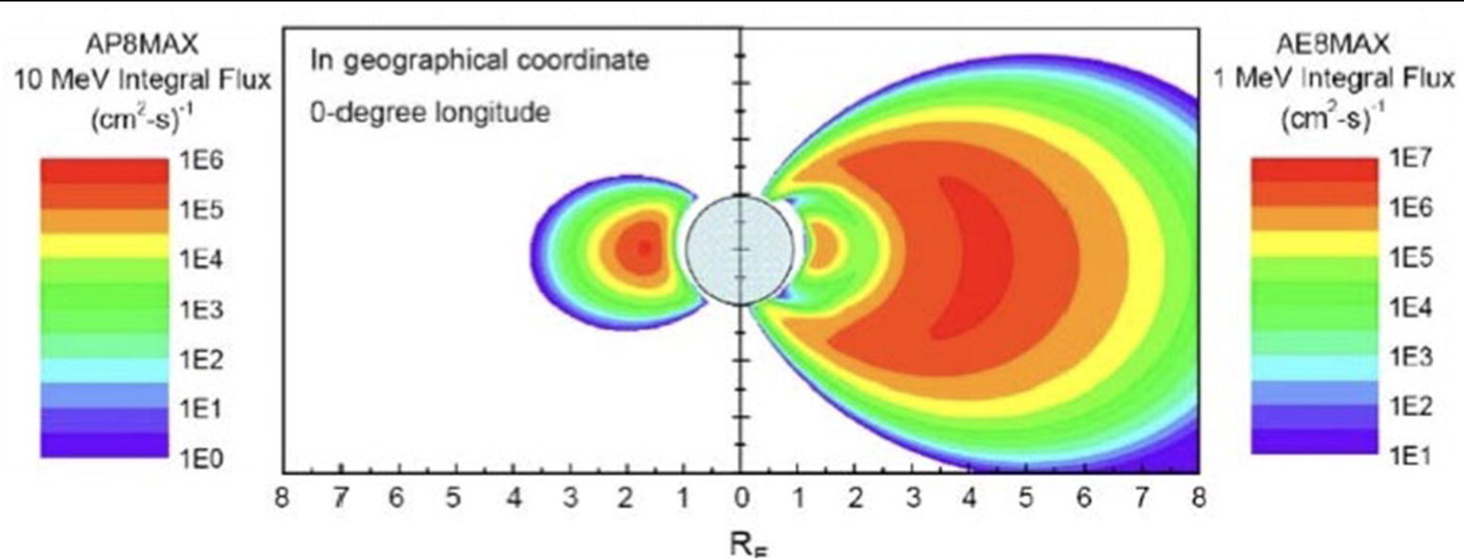
Where space radiation comes from
Galactic Cosmic Rays (GCRs)
Continuous background radiation and originates outside the solar system, such as remnants from supernova.
Mostly high-energy protons and atomics nuclei which is difficult to completely shield against.
Solar Energetic Particles (SEP)
Produced during solar activity such as solar flares and coronal mass ejections.
Primarily energetic protons, with electrons and heavier ions
Short duration, but radiation levels can rise rapidly during a major event.
Trapped Radiation
Charged particles trapped by planetary magnetic fields
Earth’s Van Allen Belts contain energetic electrons and protons
Radiation exposure depends on the spacecraft’s orbit.
[3]

Slide 5
Radiation Effects on Electronics
NASA identifies Total ionizing Dose, Displacement Damage, and Single Event Effects as the major cases of radiation effects in spacecraft electronics [5]
Total ionizing Dose: TID
Total ionizing energy deposited over time.
Can cause threshold-voltage shifts, timing changes, and part degradation.
Displacement Damage: DD
A high energy particle collides with atoms in a material and moves them from their lattice positions.
Effects Solar cells, photodiodes, optoelectronics, and semiconductor.
Single Event Effects: SEE
Single Event Upsets: SEU
Can change a stored bit from a 1 to a 0 or vice versa (bit flip).
Single event Latch-up: SEL
Creates an unwanted current condition that can potentially damage a component.
Notes:
Displacement DD specifically important for the Juno Case.
There are other Single event effects: single event transient, Single event burnout

Slide 6
Electronics consideration for Radiation environment
Shield Sensitive Electronics
Place structures between sensitive electronics and the radiation environment to minimize dose and dose rate [1].
Select Appropriate Components
Select Radiation Tolerant or Radiation Hardened electronics components.
Design for Errors
Redundancy
Automatic reset / Safe mode
Current Limiting
Recovery Algorithms

Slide 7
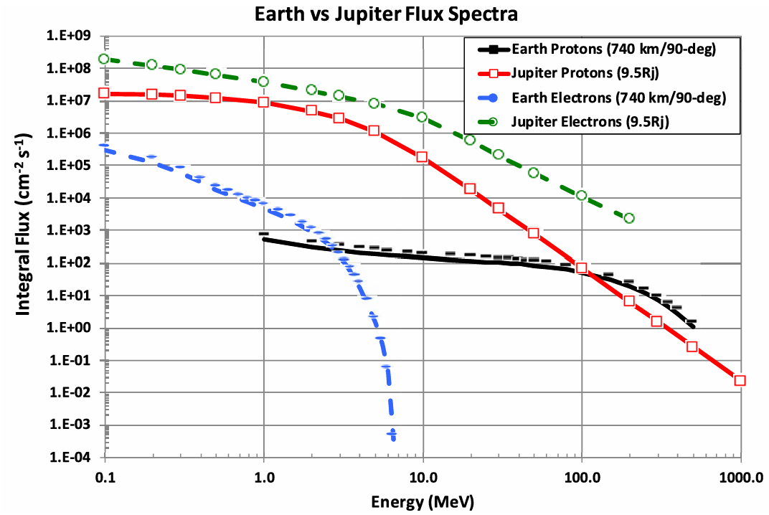
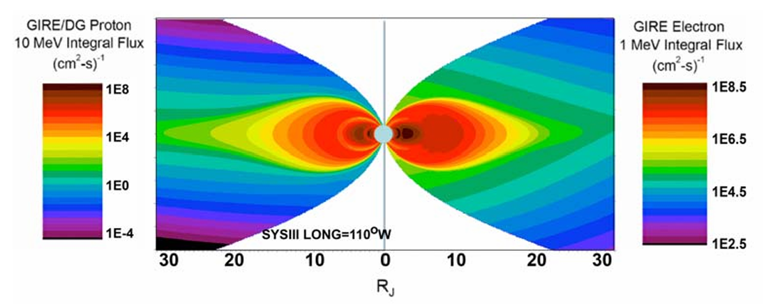
Jupiter's Radiation belts
Jupiter also has strong magnetic field that traps a huge amount of energetic charged particles just like the Van Allen Radiation belts for Earth.
Graphs shows protons and electrons in Jupiter’s inner radiation belts.
At Earth, the proton environment dominates at high energy. Compared to Jupiter, it is the high-energy electrons.
[3]
[3]

Slide 8
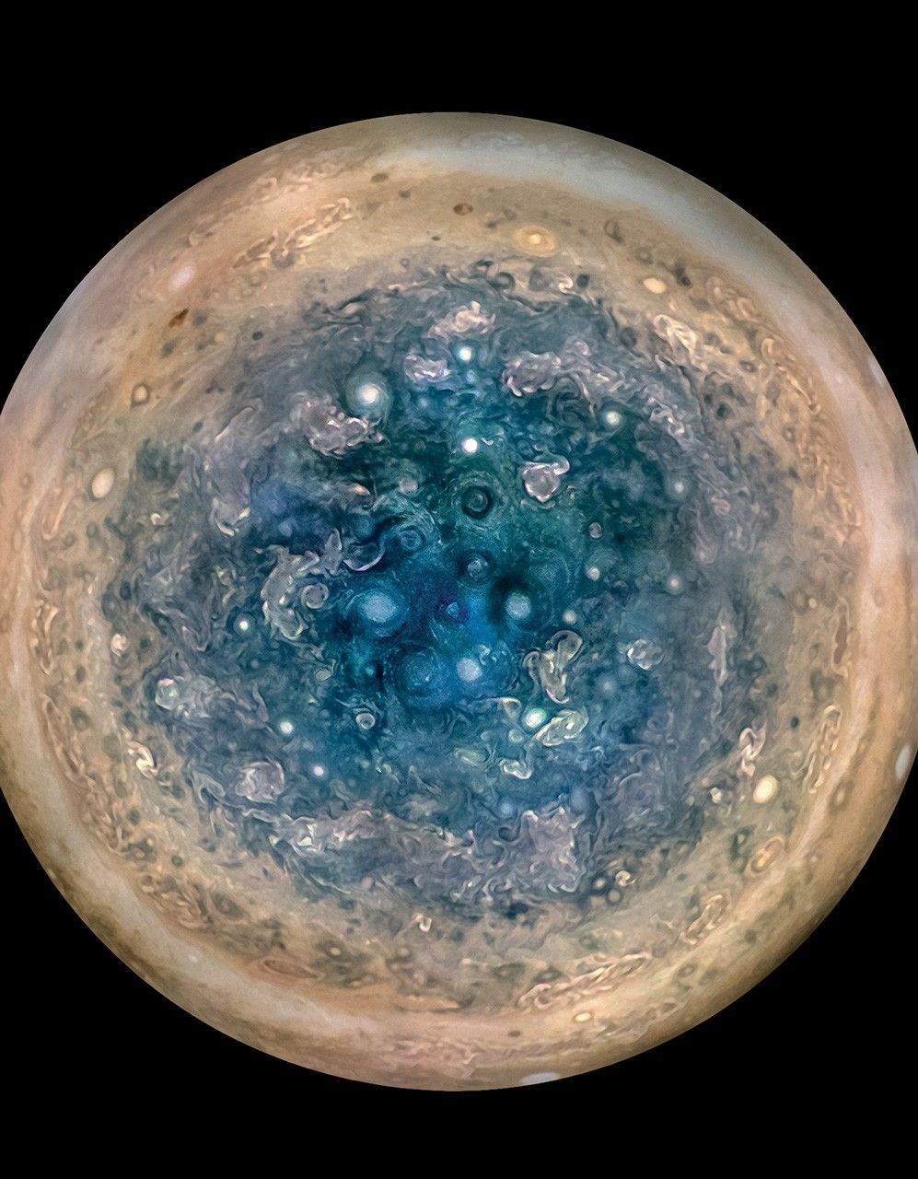
JunoCAM: Radiation degradation
Juno entered orbit around Jupiter in July 2016 to investigate the planet's structures, atmosphere, magnetic field, and origins [7].
Most of Juno’s sensitive electronics are enclosed within a 1cm thick titanium case to shield from the radiation environment.
Sensors like the JunoCam needed to be located outside the titanium walled enclosure.
JunoCam was able to take some amazing picture of Jupiter like the image shown of the Jupiter's south pole from an altitude of 52,000 kilometers.
Juno’s first 34 orbits, JunoCam operated normally, but eventually radiation damage began appearing.
Orbit 47 had the first indications of radiation damage and at orbit 56 nearly all JunoCam images were corrupted.
[6]
Notes:
This image was created using multiple images taken with the JunoCam on 3 separate orbits and then combined to show all areas in daylight.
Call back to the 5th slide were Displacement damage effects optoelectronics and semiconductors.

Slide 9
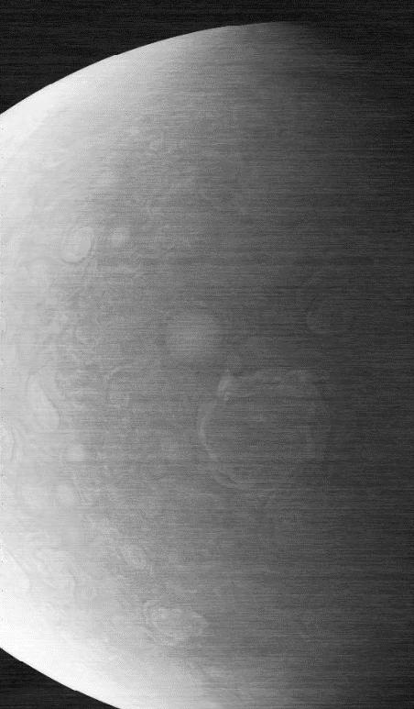
JunoCAM: Annealing Recovery
Image taken on November 22, 2023, capturing a cyclone on Jupiter's north pole.
Engineers attempted to repair the JunoCam by annealing which involves heating the device [8].
Heating semiconductor material can allow radiation-induced microscopic defects to partially reorganizing to recover.
First attempt, engineers commanded JunoCam’s heater to raised the camera temperature to 77°F and the camera began producing improved images afterwards, but the radiation exposure continued and the image problems returned.
More attempts were made and the image quality began to dramatically recover.
[8]

Slide 10
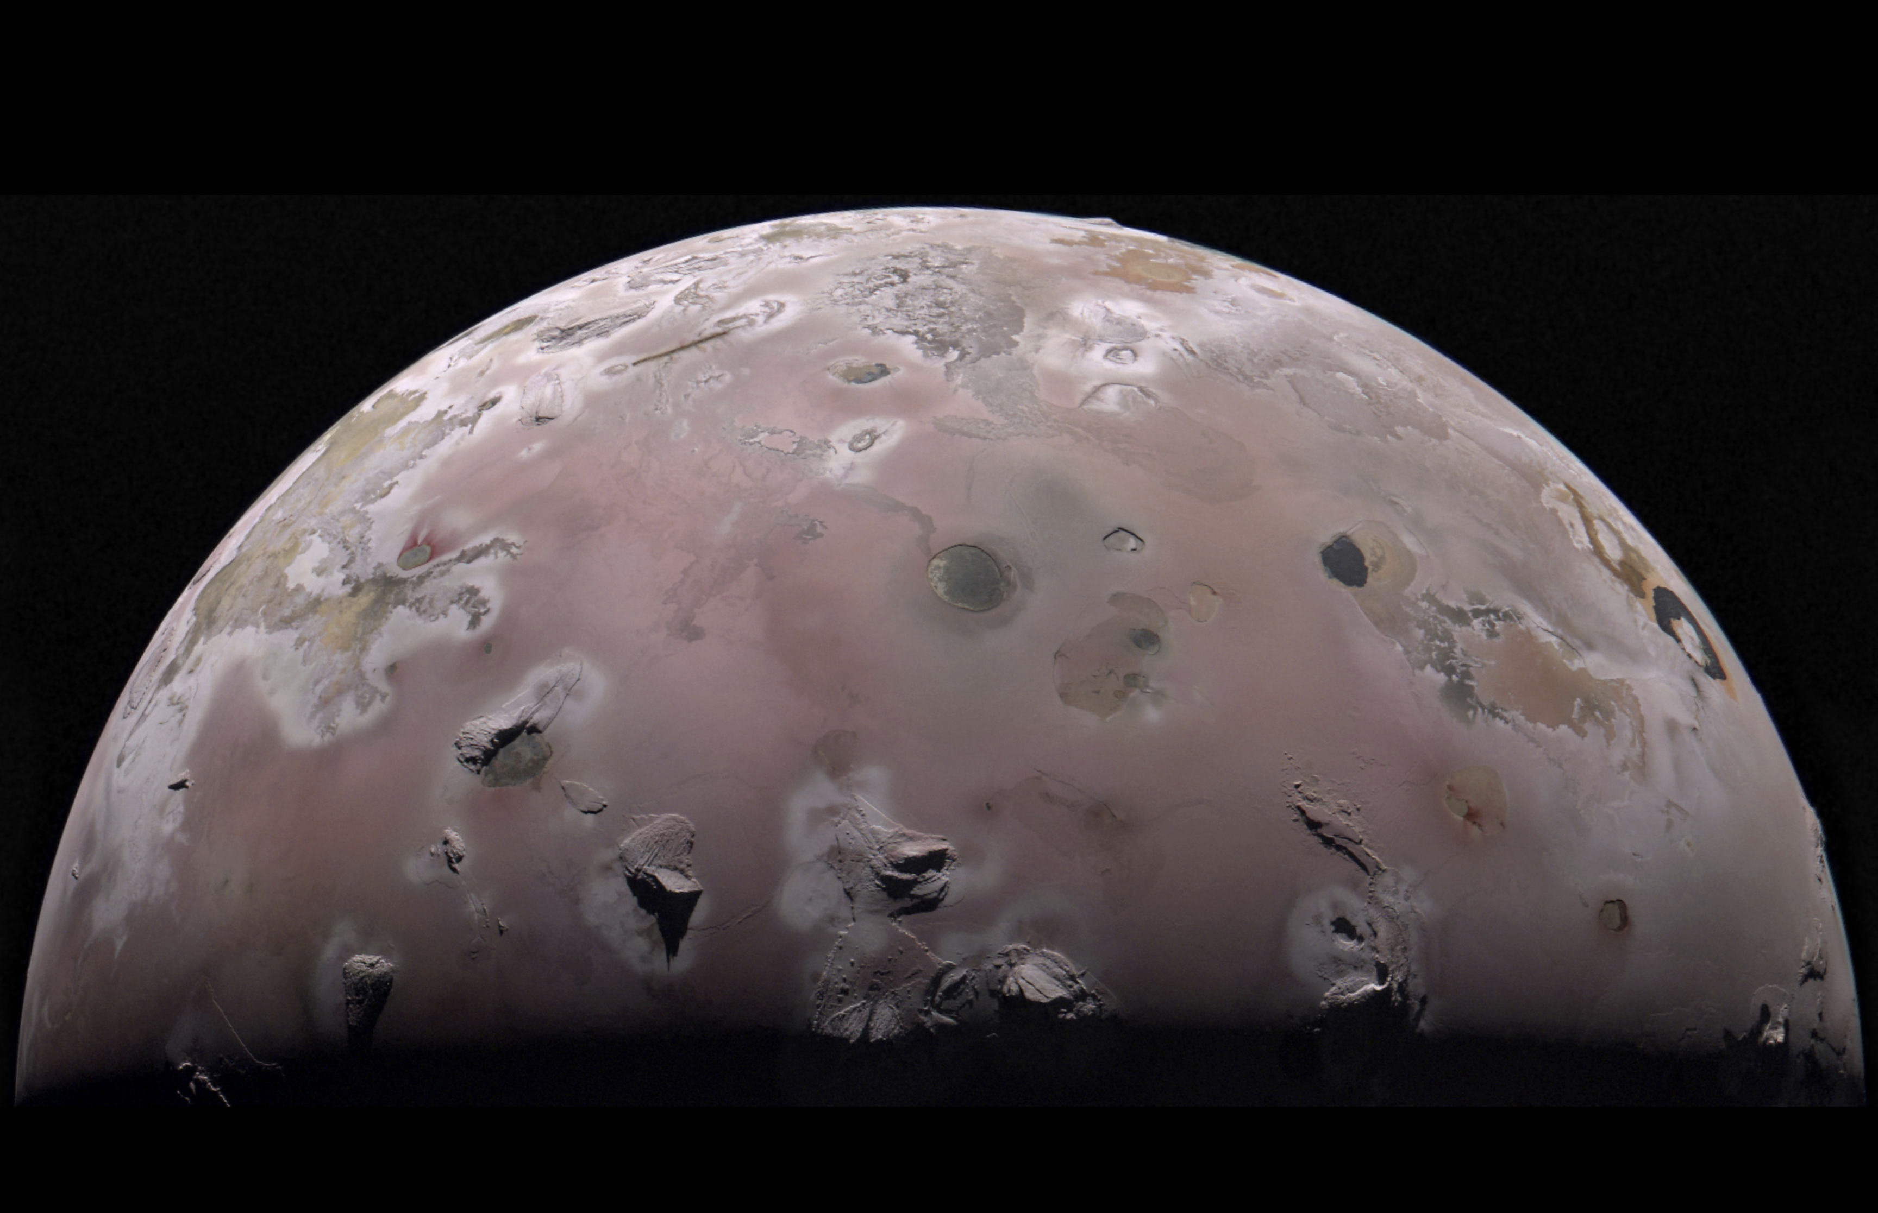
4 JunoCAM: Jupiter’s moon Io image
After the annealing attempts, NASA reported that JunoCam’s images were almost as good as when it first launched [8].
Image captured of the north polar region of Jupiter’s moon Io from Juno during the spacecraft’s 57th close pass of Jupiter taken on December 30, 2023.
However, the fix was not permanent, NASA reported in 2025 that image noise had returned during Juno’s extended mission
[8]
Notes:
Conclusion: This one issue gave us some insight in how to maintain in spacecrafts high radiation environment.
So that’s its for my presentation, hoped you learned something. Thanks.

Slide 11
References
[1] Tribble, A. C., The Space Environment: Implications for Spacecraft Design, 2nd ed., Princeton University Press, Princeton, NJ, 2003.
[2] Jun, I., Garrett, H., Kim, W., Zheng, Y., Fung, S. F., Corti, C., Ganushkina, N., and Guo, J., “A Review on Radiation Environment Pathways to Impacts: Radiation Effects, Relevant Empirical Environment Models, and Future Needs,” Advances in Space Research, 2024, A review on radiation environment pathways to impacts: Radiation effects, relevant empirical environment models, and future needs - ScienceDirect
[3] Jun, I., Garrett, H. B., and Evans, R. W., “Trapped Particle Environments of the Outer Planets,” IEEE Transactions on Plasma Science, Vol. 47, No. 8, 2019, pp. 3923–3930. Trapped Particle Environments of the Outer Planets | IEEE Journals & Magazine | IEEE Xplore
[4] NASA Space Radiation Analysis Group, “Space Radiation Frequently Asked Questions,” NASA Johnson Space Center, n.d. FAQ
[5 ]NASA Johnson Space Center, “Radiation,” NASA, 22 Jan. 2026, Radiation – NASA
[6] NASA, “JunoCam Images,” NASA Science, n.d., JunoCam Images - NASA Science
[7] NASA Jet Propulsion Laboratory, “NASA's Juno Spacecraft to Risk Jupiter's Fireworks for Science,” NASA, 4 July 2016, NASA’s Juno Spacecraft to Risk Jupiter’s Fireworks for Science – NASA
[8] NASA Jet Propulsion Laboratory, “NASA Shares How to Save Camera 370-Million-Miles Away Near Jupiter,” NASA, 21 July 2025, NASA Shares How to Save Camera 370-Million-Miles Away Near Jupiter - NASA

